Slide 1
Functional Level Strategies Week 5, Chapter 4, 2020
MGT703 Strategic Management
Notes:
USC introductory lecture slide.

Slide 3

Three key concepts from Week Three
Concept 1: VPC Model
Concept 2: VRIO Resources Model
Concept 3: The Value Chain

Slide 4

Learning objectives
Explain how an organisation can use functional level strategies to increase its efficiency.
Explain how an organisation can use functional level strategies to improve its quality.
Explain how an organisation can use functional level strategies to increase its innovation.
Explain how an organisation can use functional level strategies to increase its customer responsiveness.

Slide 5

Functional level strategies
Functional level managers need to be attentive to the day-to-day operations but always keeping in mind the alignment of daily activities to the long-term vision and objectives of the firm
Aimed at improving the company’s operations and its ability to attain superior:
efficiency.
quality.
innovation.
customer responsiveness.

Slide 6
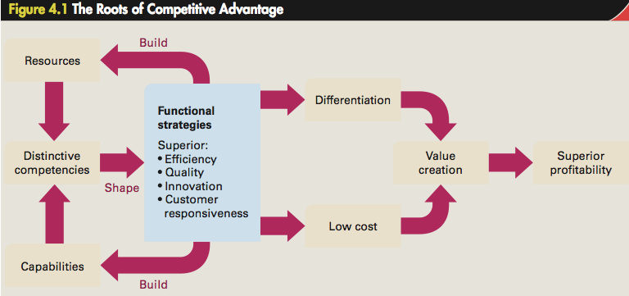
The Building Blocks of Competitive Advantage

Slide 7
Efficiency (LO1)
Efficiency
Measured by the quantity of inputs that it takes to produce a given output.
Economies of scale
Reductions in unit costs attributed to a larger output.
Ability to spread fixed costs over a large production volume and produce in large volumes to achieve greater division of labour and specialisation.
cost advantages gained from economies of scale can be made obsolete by new technologies.

Slide 8
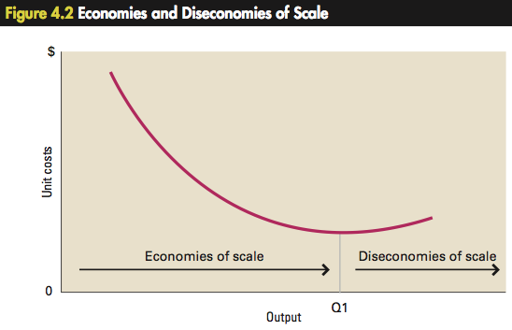
Efficiency Curve

Slide 9
Learning Effects
Cost savings that come from learning by doing.
More significant when a technologically complex task is repeated, as there is more to learn.
Diminishes in importance after a period of time.
Economies of scale can be triggered by positive changes in a company’s production system.
Diseconomies of scale can be caused by increased bureaucratic costs or lack of job satisfaction due to prolonged specialised tasks.

Slide 10
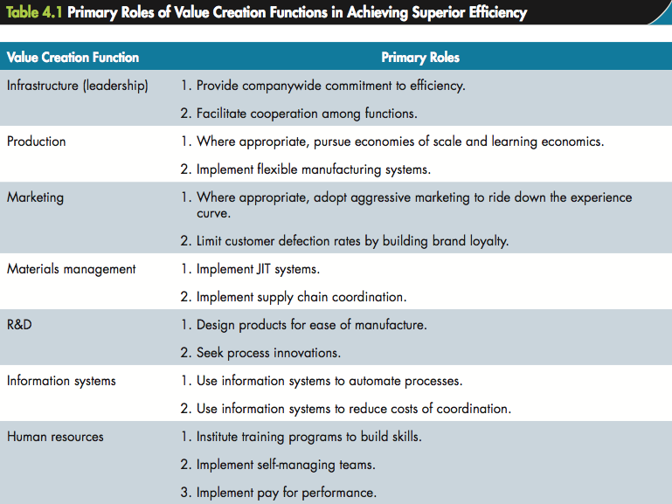
Efficiency and the Value Chain

Slide 11
Quality (LO2)
To achieve a perception of high quality of attributes the company should:
collect marketing information indicating which attributes are most important to customers.
design products in such a way that those attributes are embodied in the product.
decide significant attributes to promote and how best to position them in the minds of consumers.
recognise that competition is not stationary.

Slide 12
Quality (cont’d)
Improved quality means that costs decrease
As a result, productivity improves
Better quality leads to higher market share, allowing the company to raise prices
Higher prices increase profitability, allowing the company to stay in business
Enables the company to create more jobs

Slide 13
Quality (cont’d)
Management should strive to eliminate mistakes, defects, and poor-quality
Improve quality of supervision
Work standard to stress on quality of work
Train employees in new skills to remain informed in workplace changes
Commitment from every individual in the company to achieve better quality

Slide 14
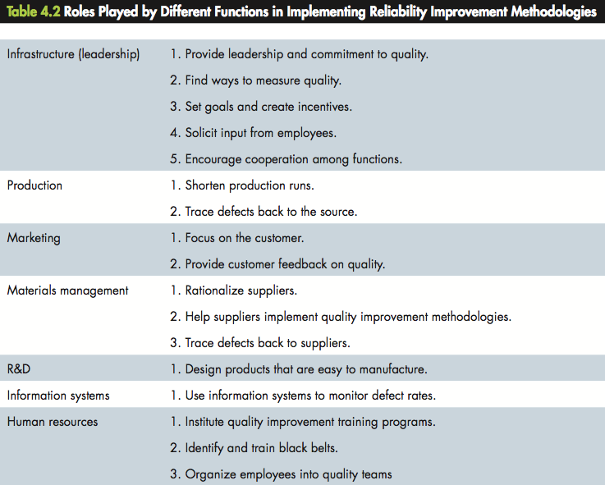
Quality and the Value Chain

Slide 15
Innovation (LO3)
Innovation ‘operationalises’ creativity
Innovative products or processes gives a company competitive advantage that allows it to:
differentiate its products and charge a premium price.
lower its cost structure below that of its rivals.
Successful new-product launches fueled by innovation are catalysts of superior profitability.

Slide 16
High fail rates of innovation attempts
Demand for innovations is essentially uncertain.
Technology is poorly commercialised.
Poor positioning strategy
Positioning strategy - Specific set of options adopts for a product based on price, distribution, promotion and advertising, and product features.
Marketing a technology for which there is inadequate demand.
Slow marketing of products.

Slide 17
Reducing fail rates of innovation
Tight cross-functional integration can help a company ensure that:
product development projects are driven by customer needs.
new products are designed for ease of manufacture.
development costs are reduced.
the time it takes to develop a product and bring it to market is minimised.
close integration between R&D and marketing is achieved.

Slide 18
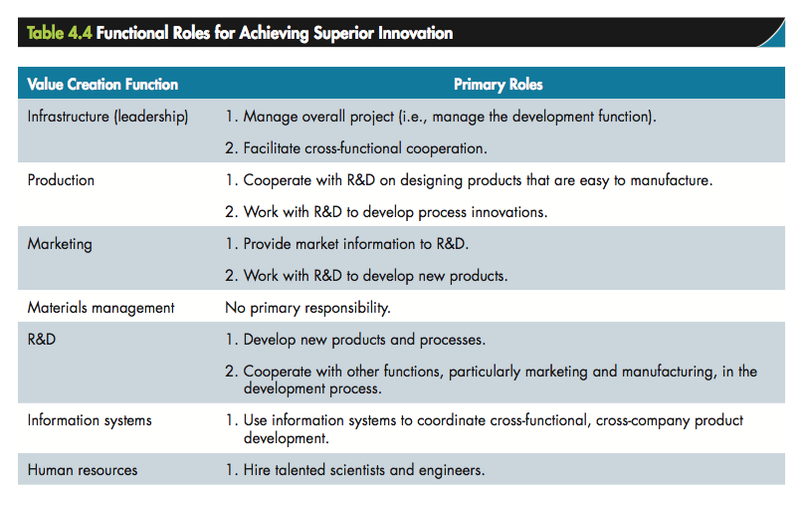
Innovation and the Value Chain

Slide 19
Customer responsiveness (LO4)
Focused on the customer
Demonstrated leadership
Shaping employee attitudes
Knowing customer needs
Satisfying customer needs
Customisation
Response times

Slide 20
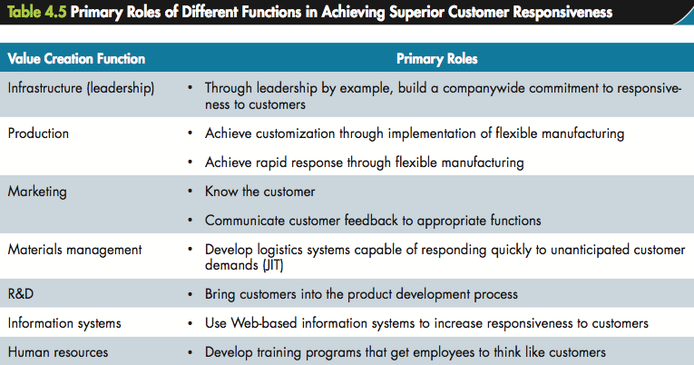
Customer responsiveness and the Value Chain

Slide 21

Generic Strategies Model
Broad market versus Narrow market
Efficiency versus Quality
Cost Leadership
Differentiation
Focus cost leadership
Focus differentiation

Slide 22
Outlook
Week 5 Post-class activities
Review guideline responses to discussion questions
Attempt Chapter 4 quiz in the online interactive textbook
Week 6: “Business Level Strategy” Pre-class activities
Read Chapter 5 of the online interactive textbook
Watch the summary video for Week 6
Prepare responses to the Week 6 discussion questions
Read the article provided on Blackboard

